Slide 1
Addressing the Needs of the Unhoused Population through
Street Medicine
Hosted by:
Anthony Menacho, MPAP, PA-C
Executive Director, Sacramento Street Medicine
Family Medicine, CommuniCare Health Centers
Notes:
Team

Slide 2
Sacramento Street Medicine
Mission
Sacramento Street Medicine exists to provide high-quality, patient-led medical care to people experiencing homelessness (PEH). We meet the needs of the people we serve where they are – on the streets and encampments throughout Sacramento.
Vision
We believe healthcare and housing are human rights. By utilizing our education in medicine and
our passion for human rights, we change lives, build services, and restore hope and power,
so that one-day compassionate care will no longer need to be delivered on the streets.
Notes:
Tony

Slide 3
Current Operation
Current Operation
6 Basic & Medical Outreach Teams
Consistent follow-up: Visit every 2 weeks to same camp, same time, generally weekends
Prioritize relationships and trust as entry point to provide care
Team Make-up
Camp Leads (Health professional student or someone with healthcare experience)
Patient Navigator (Individual with social work background to connect to services)
Medical Provider (MD, DO, PA, NP)
Medical scribe (SSM-trained scribe to assist with charting into EMR)
Basic outreach team providing survival supplies and gaining referrals for medical needs
Currently volunteer-based
200+ volunteers each year
Medical providers, medical students, graduate/undergraduate students, general public
Notes:
MK

Slide 4
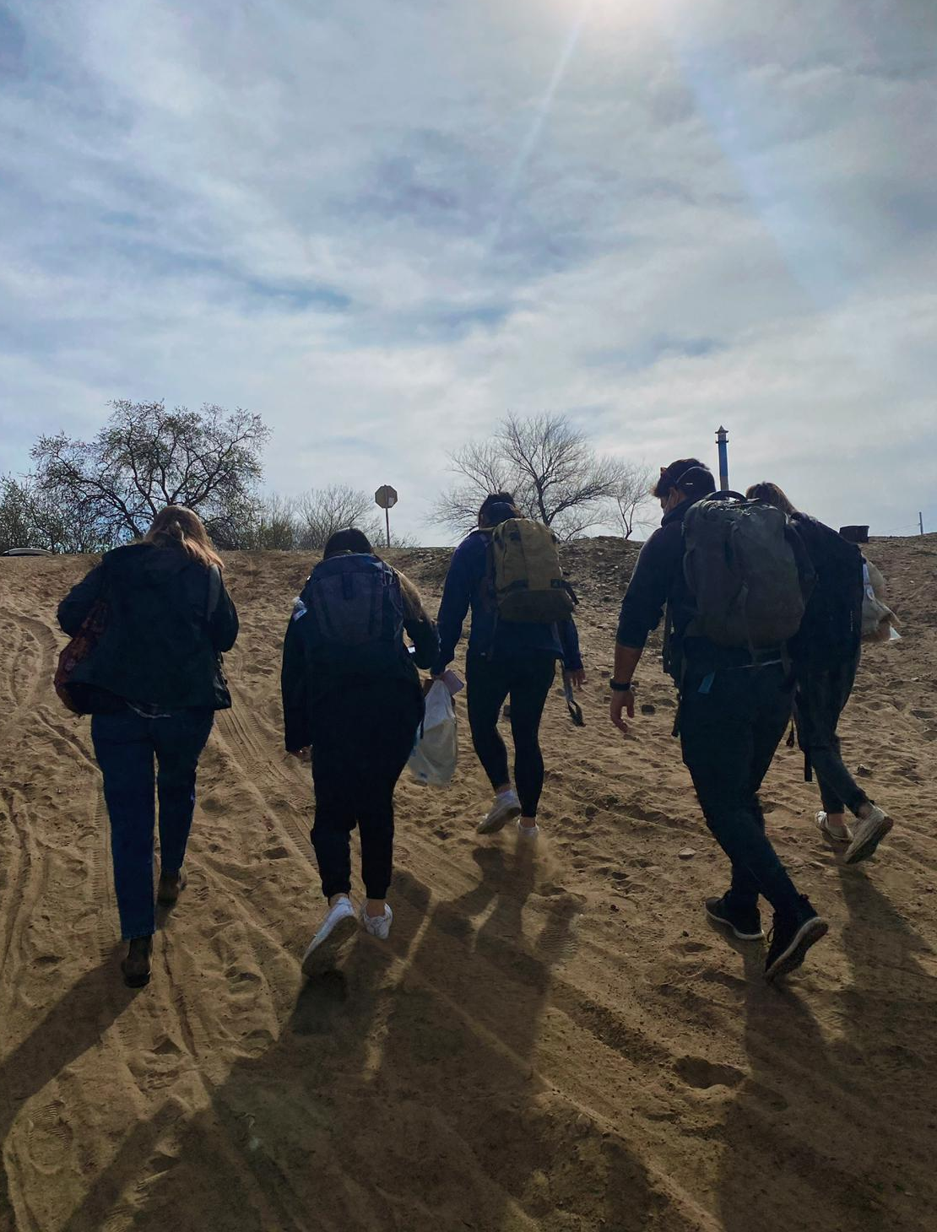
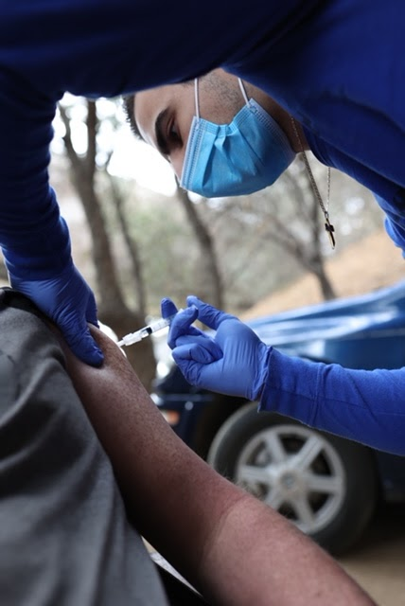
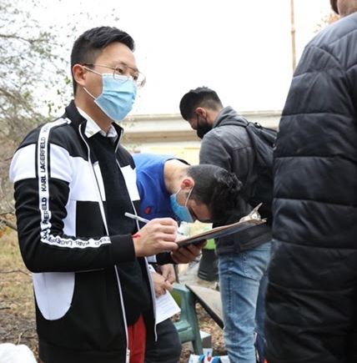
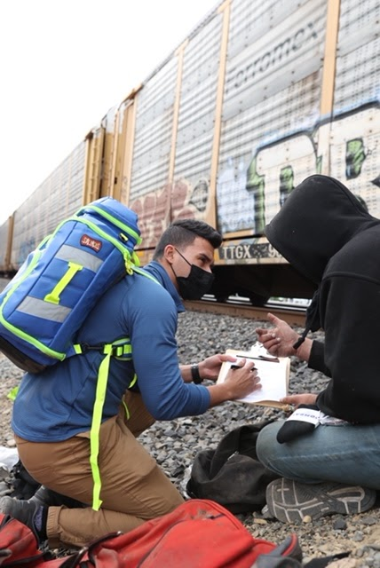
Street Outreach/Rounds
Notes:
Tony
Another slide:
More details on collaborators + partners
Assembly member
SAPs
What students we are working with -- UCD, Cal northstate, pharmacy students
How this provide opportunities to students
SRCs
Future plans … high school?

Slide 5
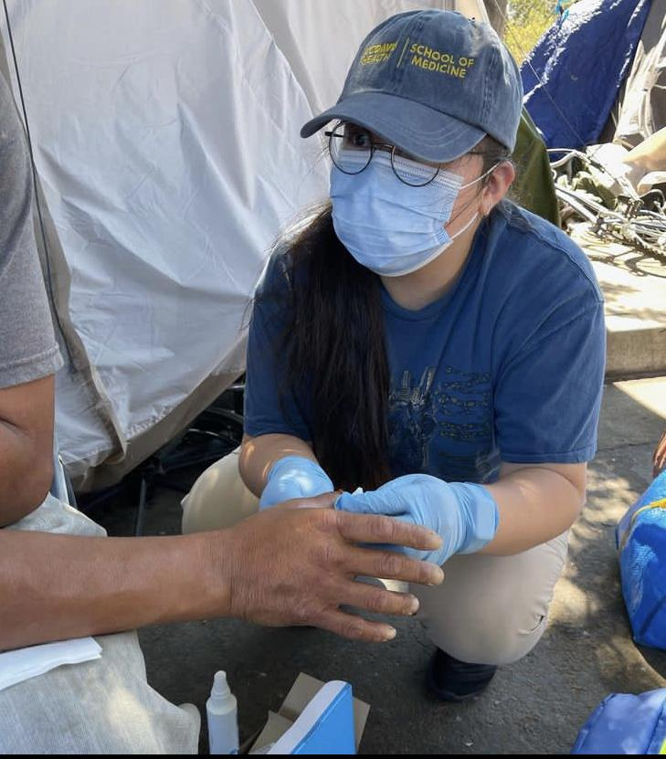
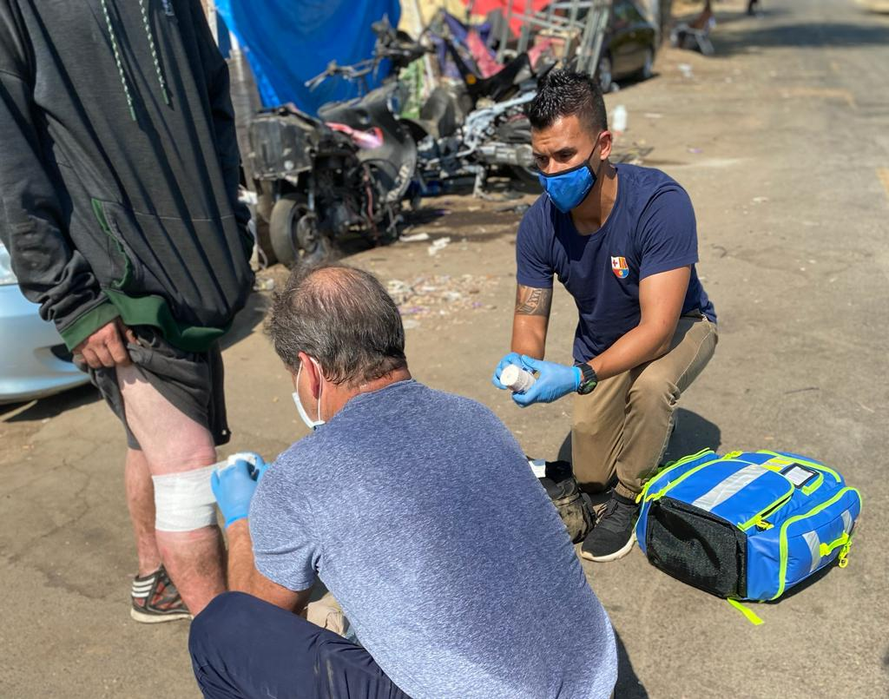
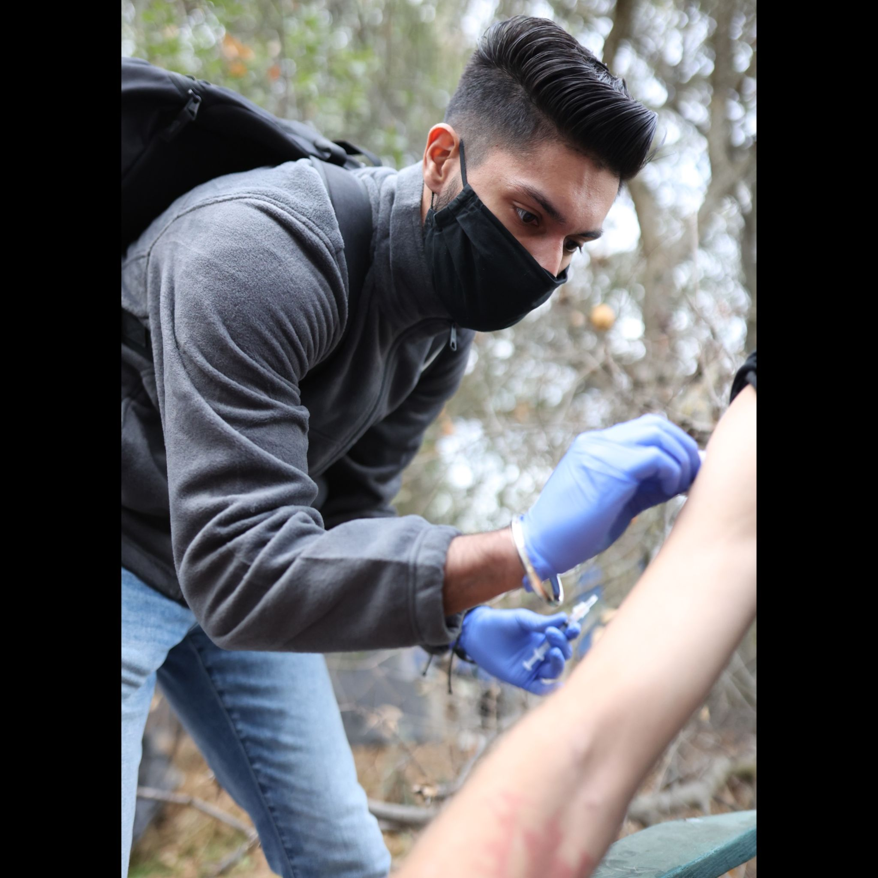
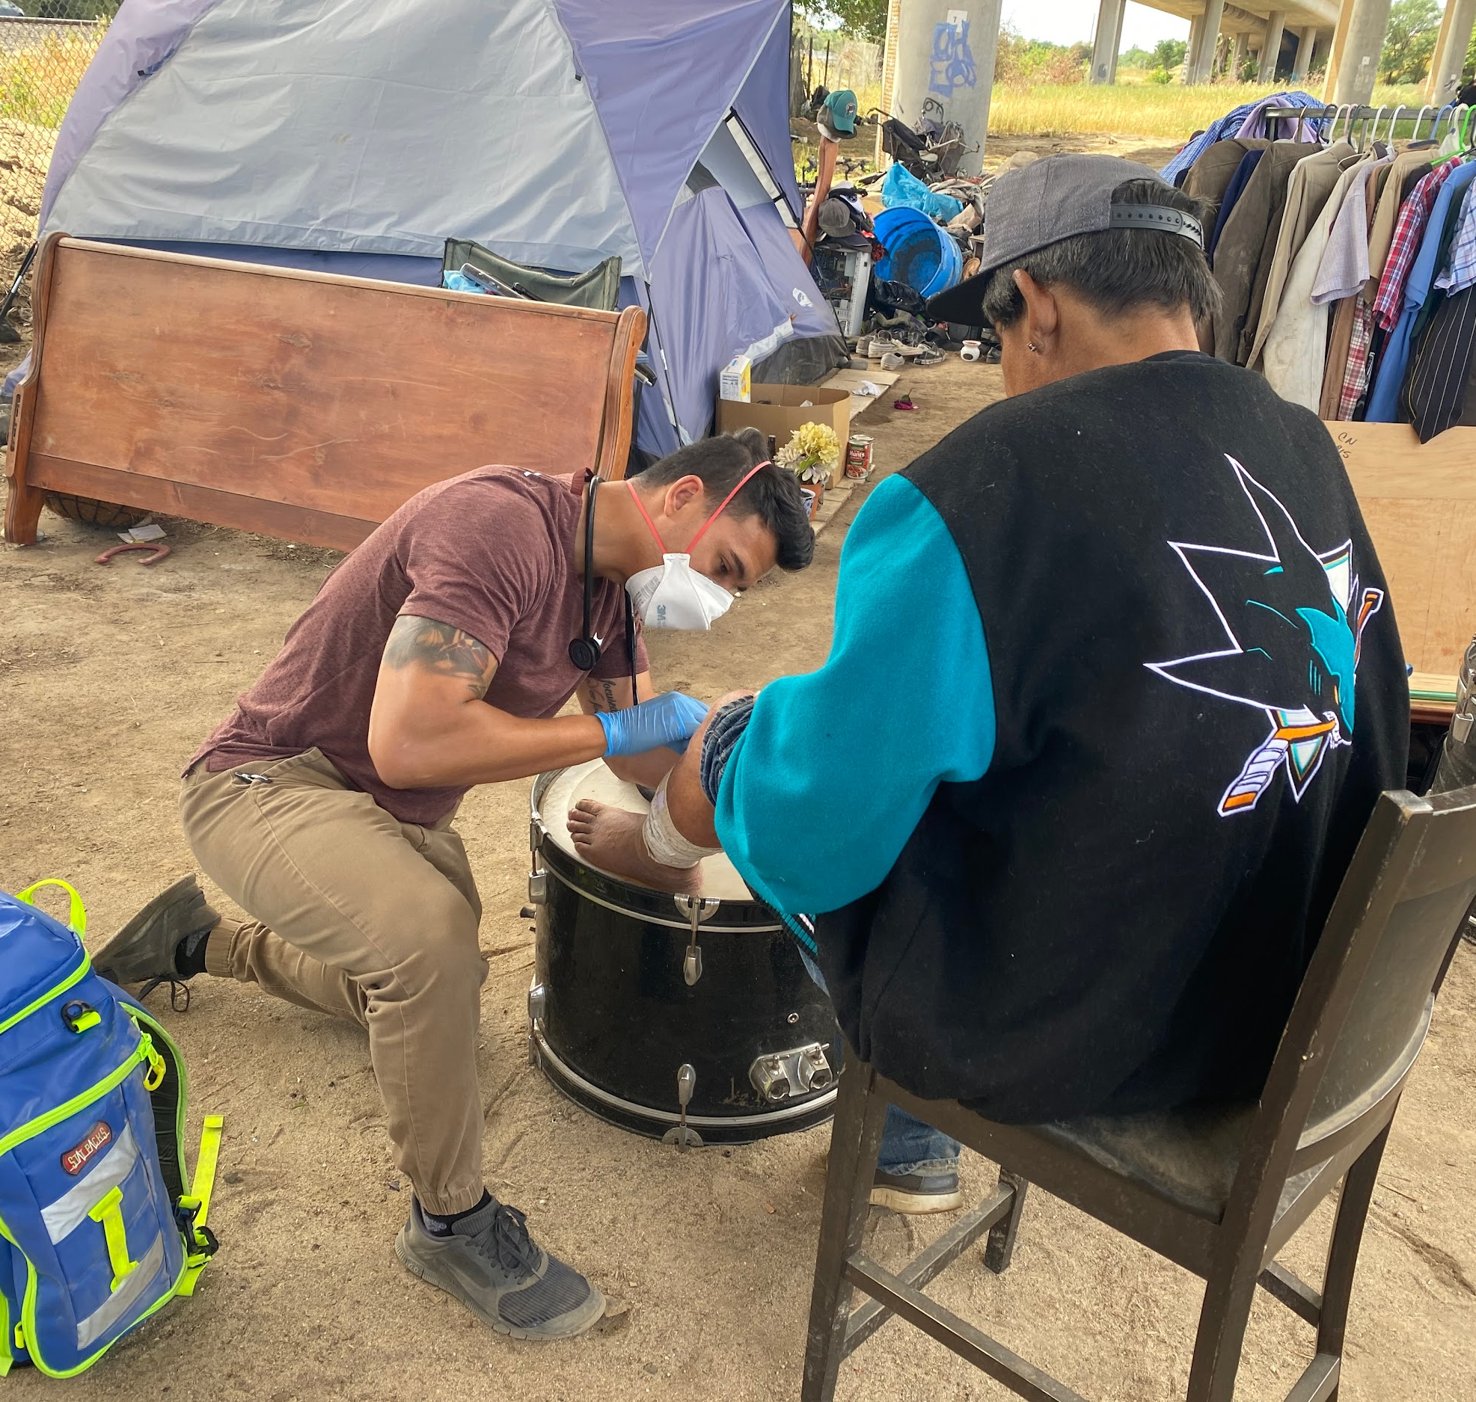
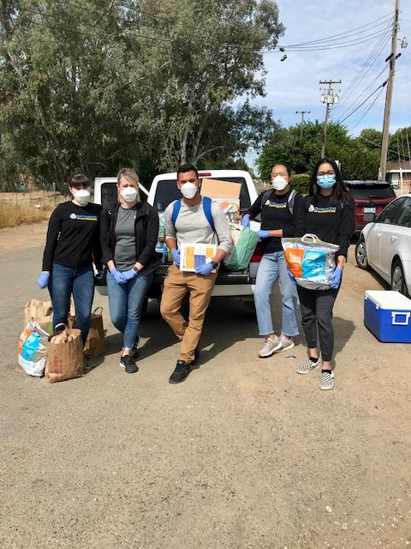
Street Outreach/Rounds
Notes:
Tony
Another slide:
More details on collaborators + partners
Assembly member
SAPs
What students we are working with -- UCD, Cal northstate, pharmacy students
How this provide opportunities to students
SRCs
Future plans … high school?

Slide 6
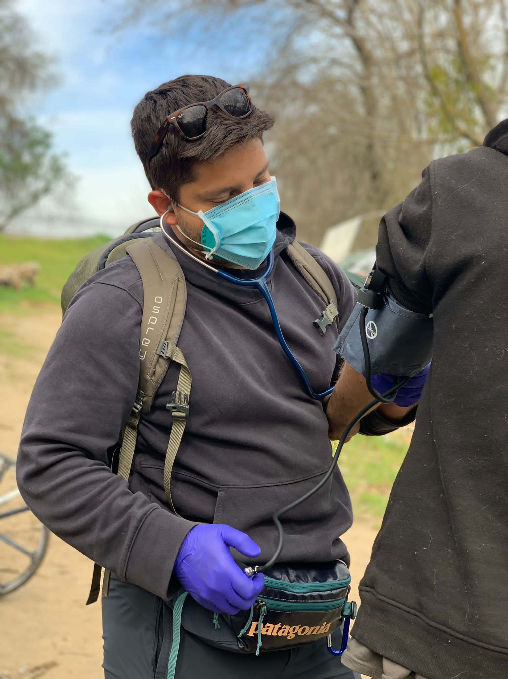
Target Population
Patient Population
Persons residing within a predetermined geographic location within Sacramento County
Persons who are currently living unsheltered
Person has a medical need our team can manage within our defined scope of practice
Persons are enrolled based on medical necessity irrespective of their insurance or ability to pay
All efforts done in coordination and collaboration with other street medicine efforts and community services
Notes:
MK

Slide 7
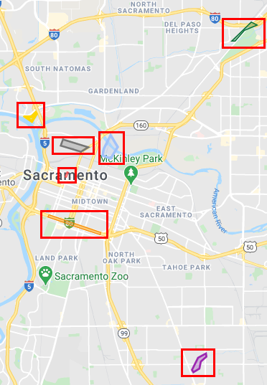
Where We Serve
The largest Sacramento encampments with the highest medical need.
The Island
Loaves and Fishes
Basler Road / River
Downtown
X Street
Roseville Rd
Morrison
Notes:
https://www.google.com/maps/d/u/0/viewer?mid=1ckfMx2EAkswQxro1Uw0Jcrw89Z452Foc&shorturl=1&ll=38.5776825533162%2C-121.45826062999318&z=12

Slide 8
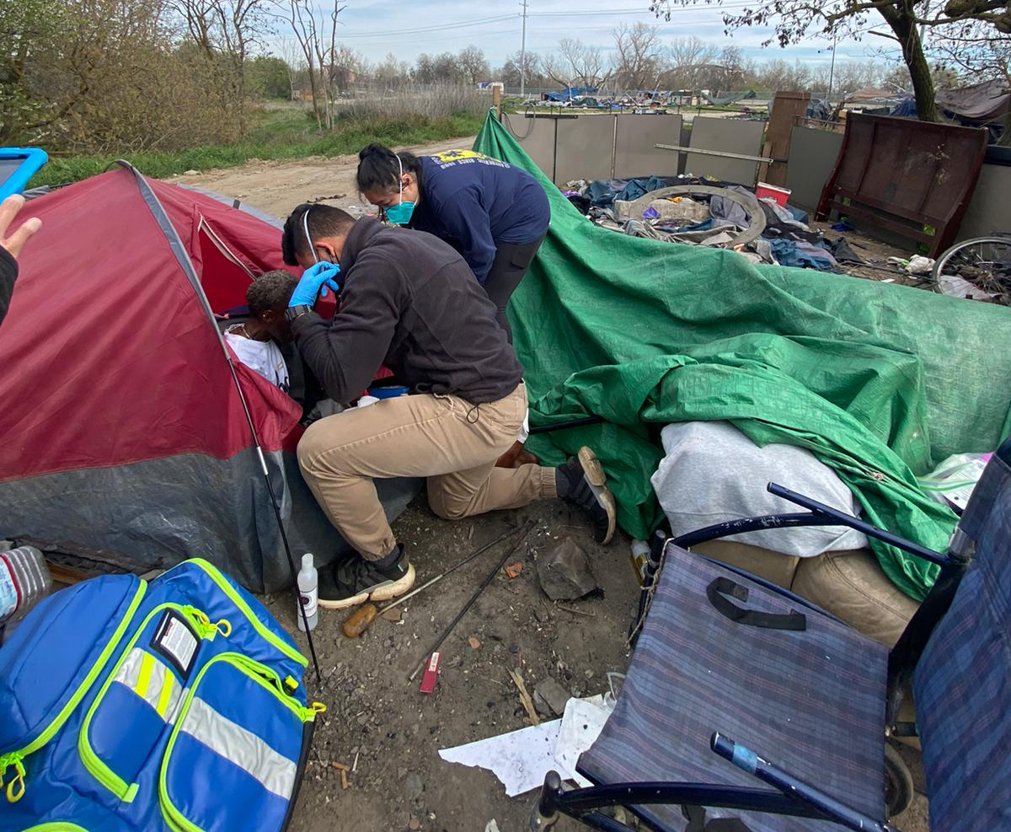
Scope of Services
Current Services
Primary care services (hypertension, diabetes, COPD/Asthma, heart failure)
On-site medications dispensing
Wound care
Harm reduction services (Syringe exchange, naloxone distribution)
Point of care lab testing (A1c, hemoglobin, random blood sugar)
Minor Procedures
COVID Testing
Future Services
STI/STD Screening (Rapid gonorrhea, chlamydia, HIV, syphilis)
Diagnostic imaging & lab referrals
Specialty referrals
Drawing labs in the field
Notes:
MK

Slide 9
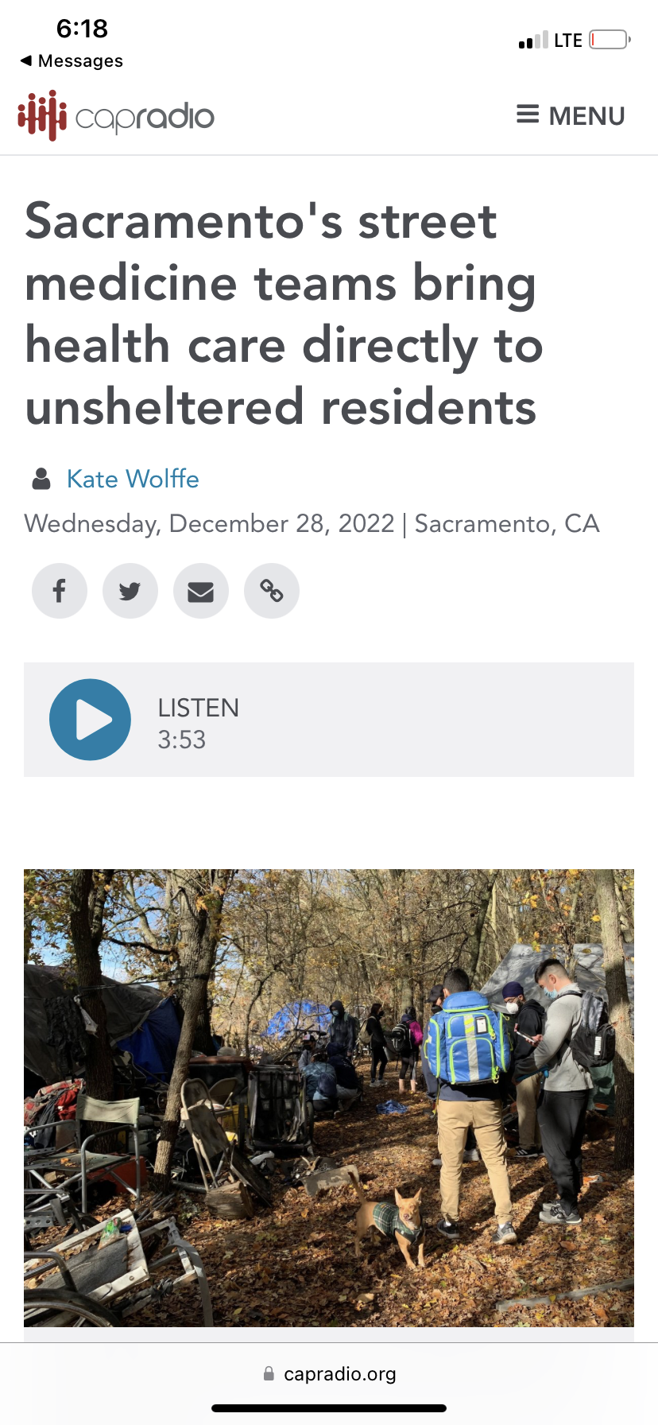
Sacramento Street Medicine Outcomes 2021-22
Persons served: 300 every 2 weeks*
Students trained: 400+ undergraduate/100+ healthcare professional
Decreased ER visits per year
Decreased hospital visits per year
Increased connection to brick & mortar PCP
Increased connection to social services (i.e HOPE, Sac Covered)
*Includes providing both basic survival supplies and medical care
Njknknjk
Notes:
MK

Slide 10
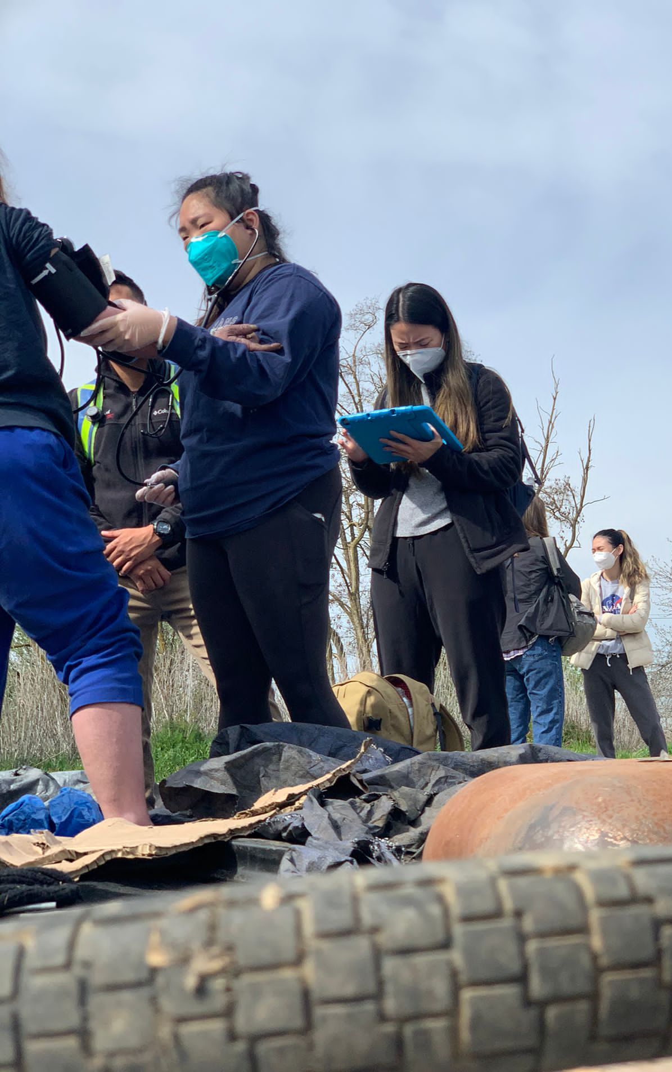
Growth Plan & Target Measures
Growth Plan
Partner with current street medicine providers in the community
Move one full-time team to multiple days during the week
Partner with established street medicine programs to help provide path to sustainability
Expand provider capacity to reach larger number of PEH
Target Measures
Decrease disparity of standard healthcare quality metrics
Increase establishment primary care relationship
Develop a system to determine emergency room usage and diversion
Develop a process of tracking hospital readmission rate, length of stay
Organize referral process for specialty care, behavioral health, drug treatment
Target expedited housing placement for those with extensive needs
Increase penetration of social services to highest need population
Notes:
Tony

Slide 11
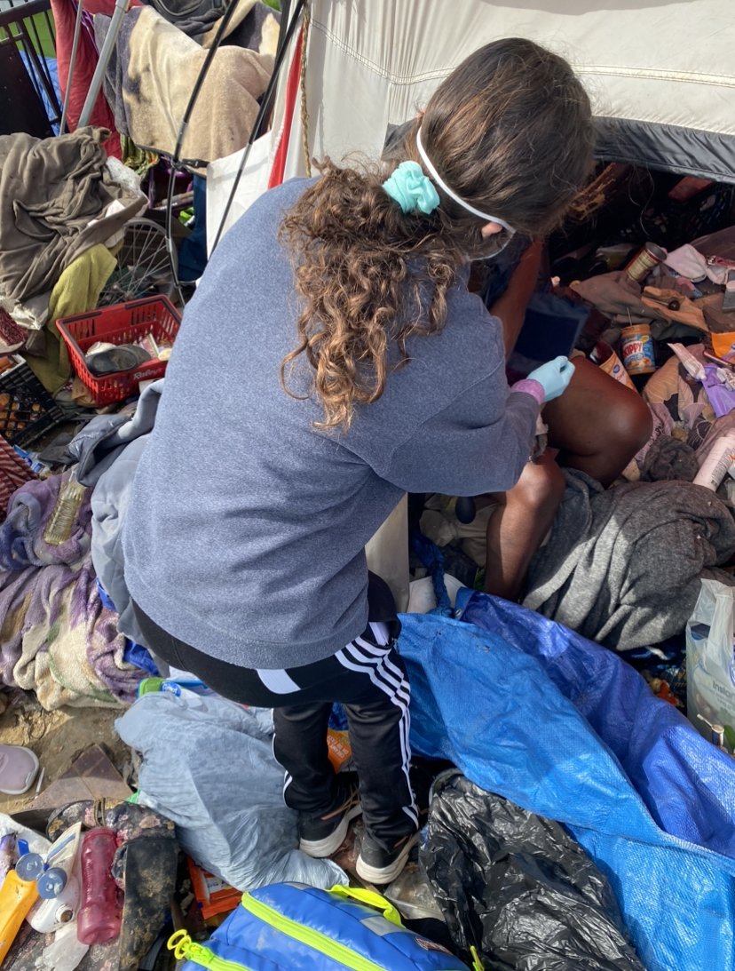
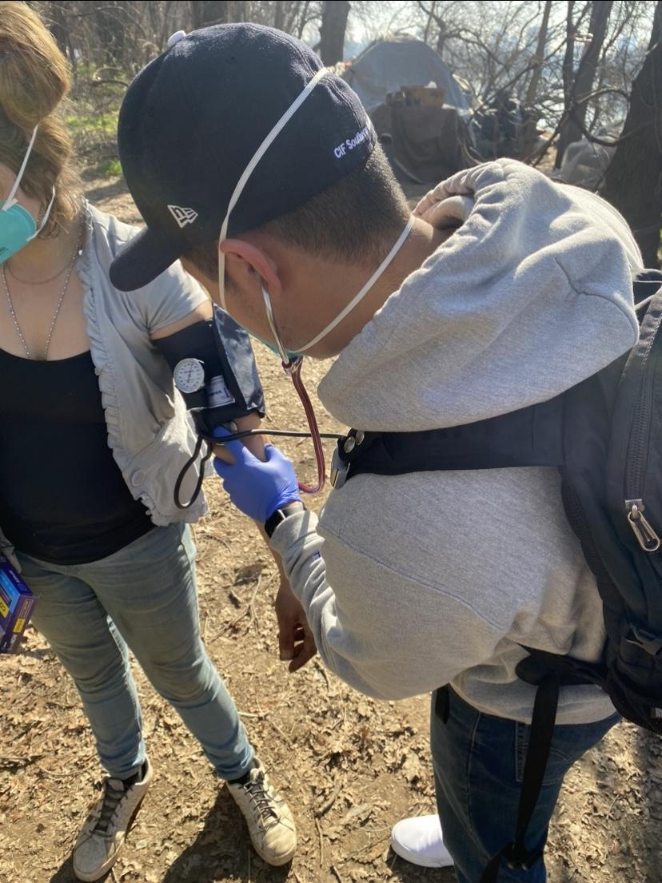
Integration & Coordination
Barriers
Understanding the landscape of parties involved in street medicine
Establishing best use of resources based on capacity
Funding strategies available for sustainable services
Maintaining patient relationships within and across organizations
Positives
Leaders within have extensive experience in working with PEH
Coordination meetings happening bi-weekly between organizations
Policy and healthcare prioritizing the healthcare for folks living outside
Notes:
Tony

Slide 12
Community Partners
Academia
Keck School of Medicine of USC Street Medicine - Brett Feldman, Director of USC Street Medicine
UC Davis School of Medicine - Dr. MK Orsulak, Family Medicine Physician
California Northstate University, School of Medicine & Pharmacy - Dr. Xiaodong Feng, Dean
Sacramento State University - Dr. Jennifer Kenney, Department of Social Work
Sacramento State University - Dr. Susanna Curry, Department of Social Work
American River College, Sacramento City College, Consumnes River College
Homeless Services
HOPE Cooperative - Joseph Smith, Director
Sacramento Steps Forward - Dr. Tamu Green, Systems Performance
Safer Alternatives Through Networking & Education - Rachel Anderson, Executive Director
Sacramento Homeless Union - Crystal Sanchez, President
SEVA Selfless Service - Jaspreet Khunkhun, Co-Founder
Future Community Church - Stefon DuBose, Pastor
Francis House - Cynthia, Pimentel, Program Manager
Notes:
Outcomes slide - Tony

Slide 13
Who We Work With: Healthcare Partners
Clinics/Health Organizations
Street Medicine Institute
UC Davis Student-run Clinic, Willow Clinic
UC Davis Student-run Clinic, Joan Viteri Memorial Clinic
UC Davis Student-run Clinic, Tepati
Alameda County Healthcare for the Homeless
Portland Street Medicine
Syringe Exchange Programs and Narcan Delivery
Government Agencies
City of Sacramento, Office of Community Response
Sacramento Emergency Medical Services (EMS)
Sacramento County Department of Public Health
California Department of Public Health
Political Support
California Assembly Majority Leader - Eloise Gomez Reyes, 47th Assembly District
Notes:
Tony

Slide 14
Who We Work With: Academic Partners
- Mary Kathryn Orsulak, MD, Primary Care Physician
- Holly Kirkland-Walsh, NP, Wound Care Specialist
- Brett Feldman, PA-C, Director of USC Street Medicine
- Corinne Feldman, PA-C, Director of Clinical Skills
- Dr. Kevin Lohenry, Director of USC PA Program
- Xaiodong Feng, MD, Dean
- Jennifer Courtney, PharmD, Director of Education
- Ashim Malhotra, Dean of Curriculum Development
- Jennifer Kenney, PhD, Department of Social Work
- Susanna Curry, PhD, Department of Social Work
Notes:
Tony
Academia:
Keck School of Medicine of USC - Dr. Kevin Lohenry, Director of USC PA Program
UC Davis School of Medicine and School of Nursing - Dr. MK Orsulak, Family Medicine Physician
California Northstate University, School of Medicine & Pharmacy - Dr. Xiaodong Feng, Dean
Sacramento State University - Dr. Jennifer Kenney, Department of Social Work
Sacramento State University - Dr. Susanna Curry, Department of Social Work
American River College, Sacramento City College, Consumnes River College
Homeless Services
Loaves & Fishes - Joe Smith, Advocacy Director
Sacramento Steps Forward - Dr. Tamu Green, Systems Performance
Sacramento Regional Coalition to End Homelessness - Bob Erlenbusch, Executive Director
Sacramento Homeless Union - Crystal Sanchez, President
SEVA Selfless Service - Jaspreet Khunkhun, Co-Founder
Future Community Church - Stefon DuBose, Pastor
Francis House - Cynthia, Pimentel, Program Manager

Slide 15
Who We Work With: Community Partners
Notes:
MK
Outcomes slide - Tony
Academia:
Keck School of Medicine of USC - Dr. Kevin Lohenry, Director of USC PA Program
UC Davis School of Medicine and School of Nursing - Dr. MK Orsulak, Family Medicine Physician
California Northstate University, School of Medicine & Pharmacy - Dr. Xiaodong Feng, Dean
Sacramento State University - Dr. Jennifer Kenney, Department of Social Work
Sacramento State University - Dr. Susanna Curry, Department of Social Work
American River College, Sacramento City College, Consumnes River College
Homeless Services
Loaves & Fishes - Joe Smith, Advocacy Director
Sacramento Steps Forward - Dr. Tamu Green, Systems Performance
Sacramento Regional Coalition to End Homelessness - Bob Erlenbusch, Executive Director
Sacramento Homeless Union - Crystal Sanchez, President
SEVA Selfless Service - Jaspreet Khunkhun, Co-Founder
Future Community Church - Stefon DuBose, Pastor
Francis House - Cynthia, Pimentel, Program Manager
Coalitions
Services Not Sweeps Coalition - 100 Homeless Advocate Groups
Weather Responsiveness Task Force

Slide 16
“Besides quality care, humility within the healthcare field is essential to reduce biases, remove inequities, and improve communication that addresses the healthcare issues of all people”
Humility is bringing compassionate care to the people.
Notes:
Team

Slide 17
Contact
Anthony Menacho, MPAP, PA,C
Executive Director, Sacramento Street Medicine
Personal: menacho.anthony@gmail.com
SSM Email: sacstreetmed@gmail.com

