Slide 1
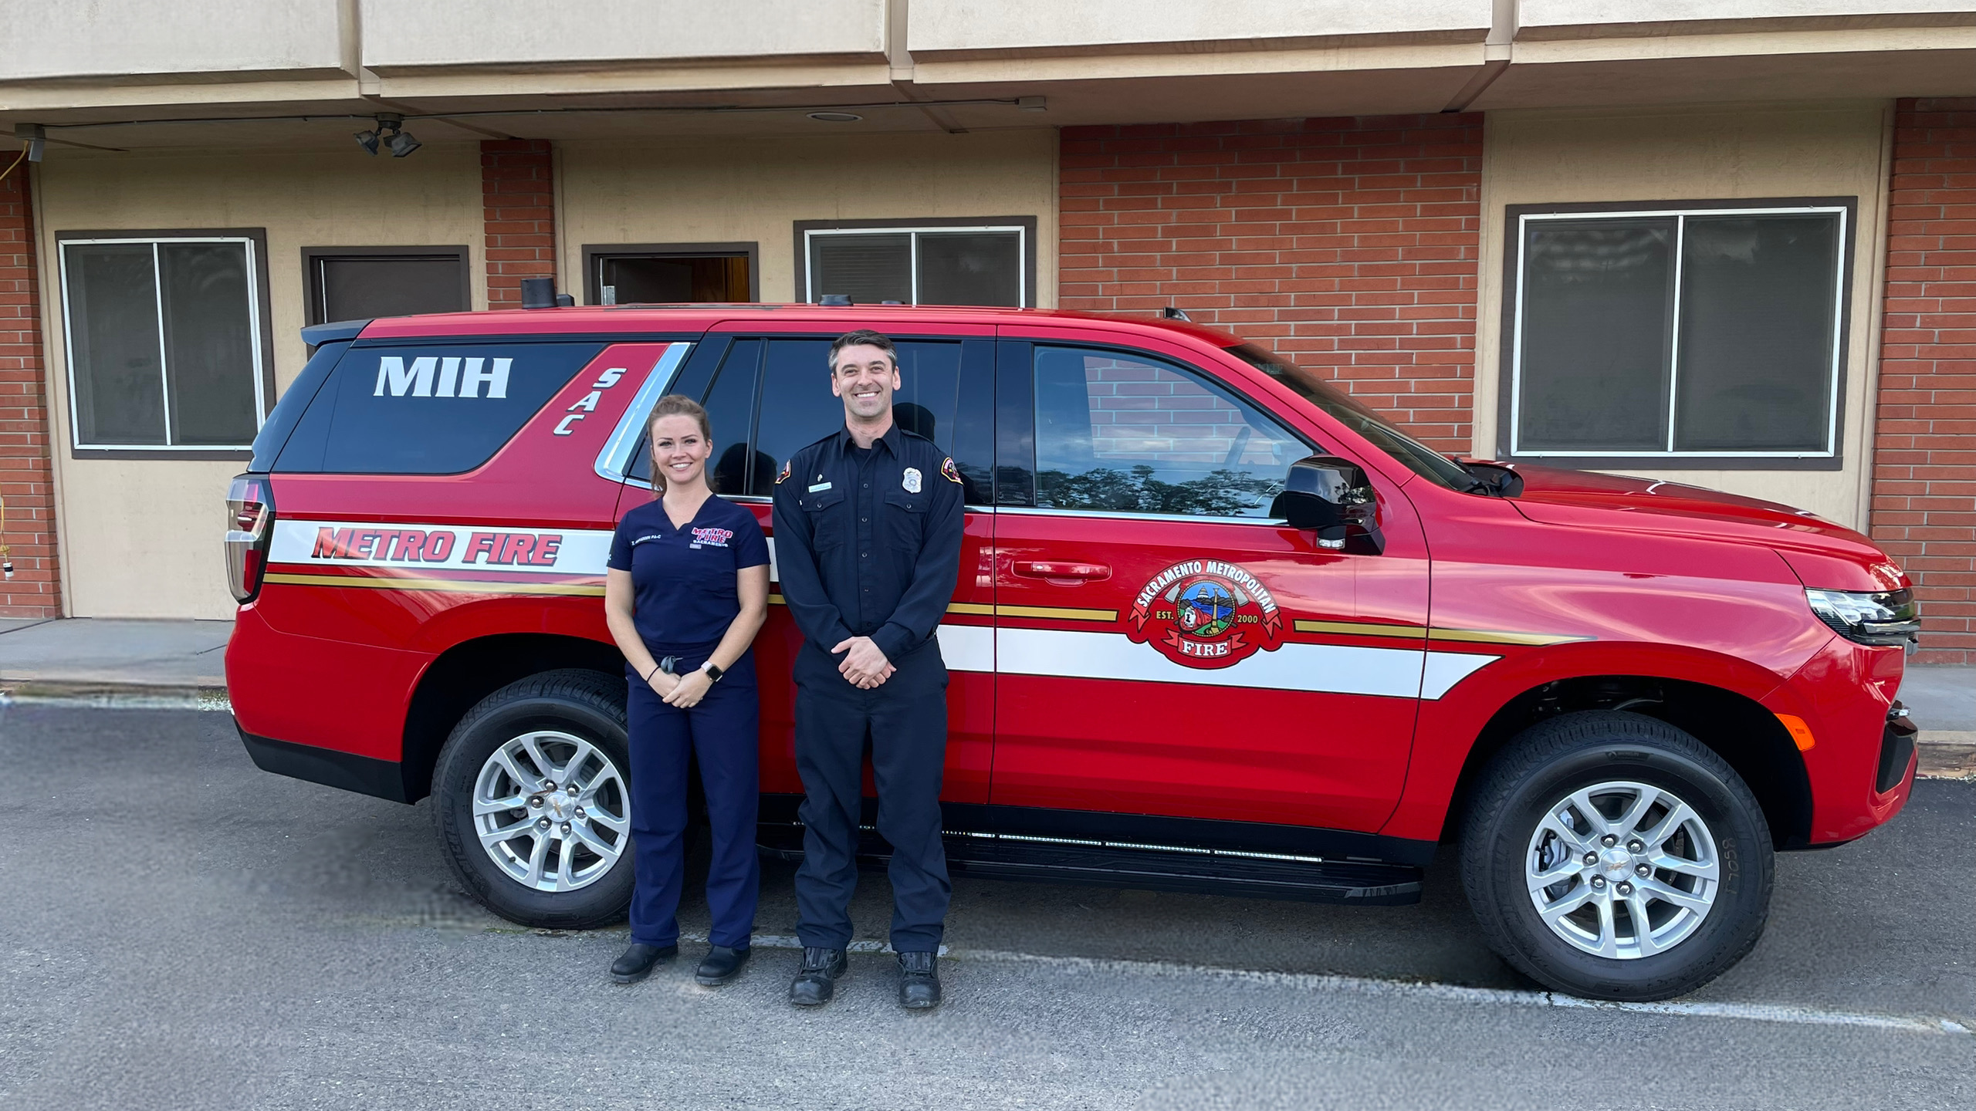
SacMIH
The first year

Slide 2


Slide 3

Improve continuity of care for high utilizers of EMS and ED services
Reduce unnecessary EMS transports and ED visits
Reduce hospital readmissions
Reduce health care expenditures
Expedite appropriate care for patients calling 911
Provide appropriate care for behavioral health patients encountering 911 services

Slide 4


COVID start up April 1st 2020
April 1st - June 30th 2020 4,600 COVID swabs
Sept. 23, 2020 – June 30, 2021 28,999 COVID swabs
Internal Public Safety Testing 2,371 COVID swabs
Grand Total 35,970 COVID swabs

Slide 5
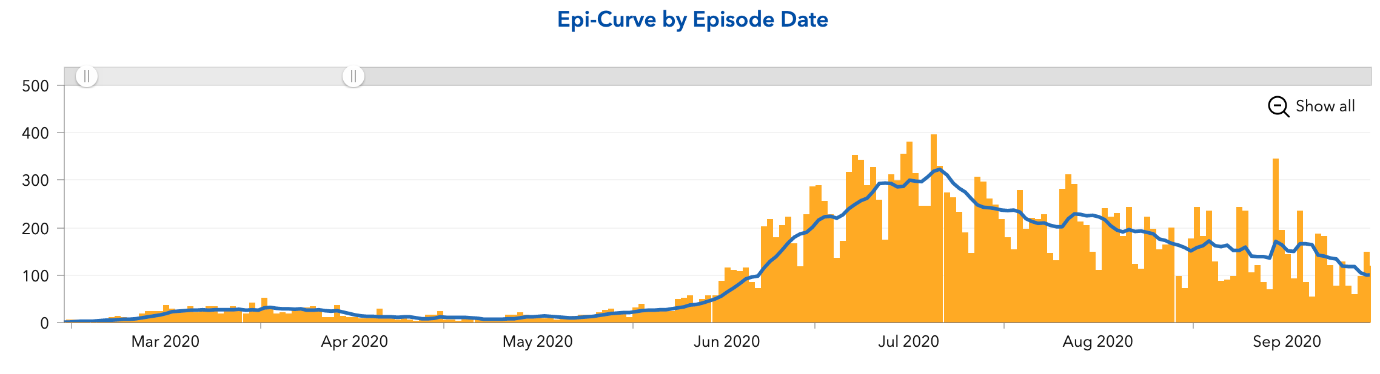
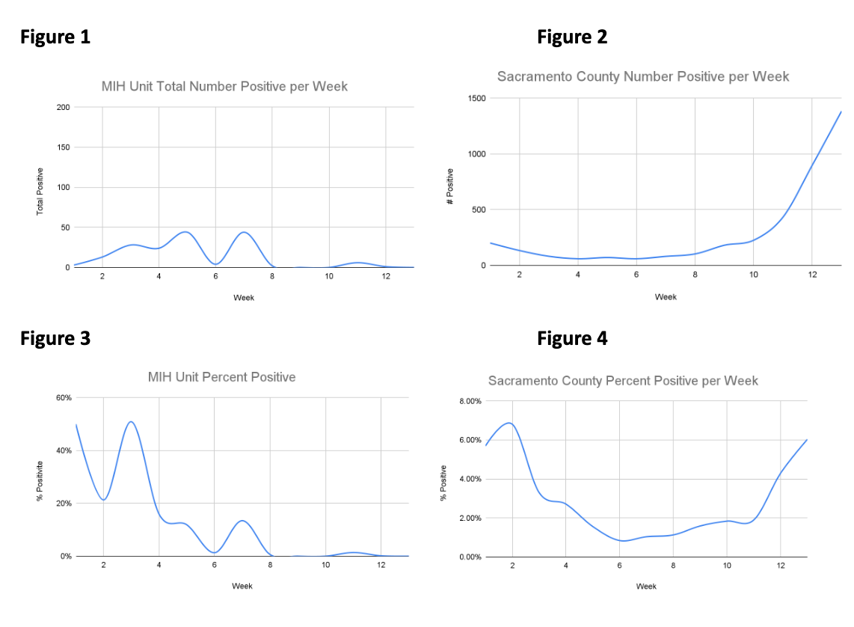
How the MIH response saved lives
MIH time period
MIH covid testing data (figure 1&3) compared to general county data (Figure 2 &4) from 4/1/2020 to 6/30/2020

Slide 6
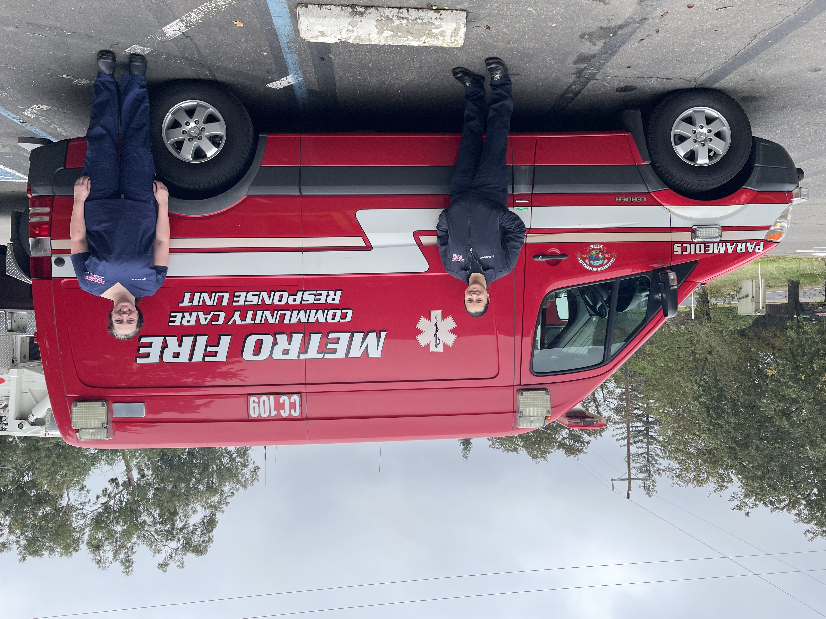
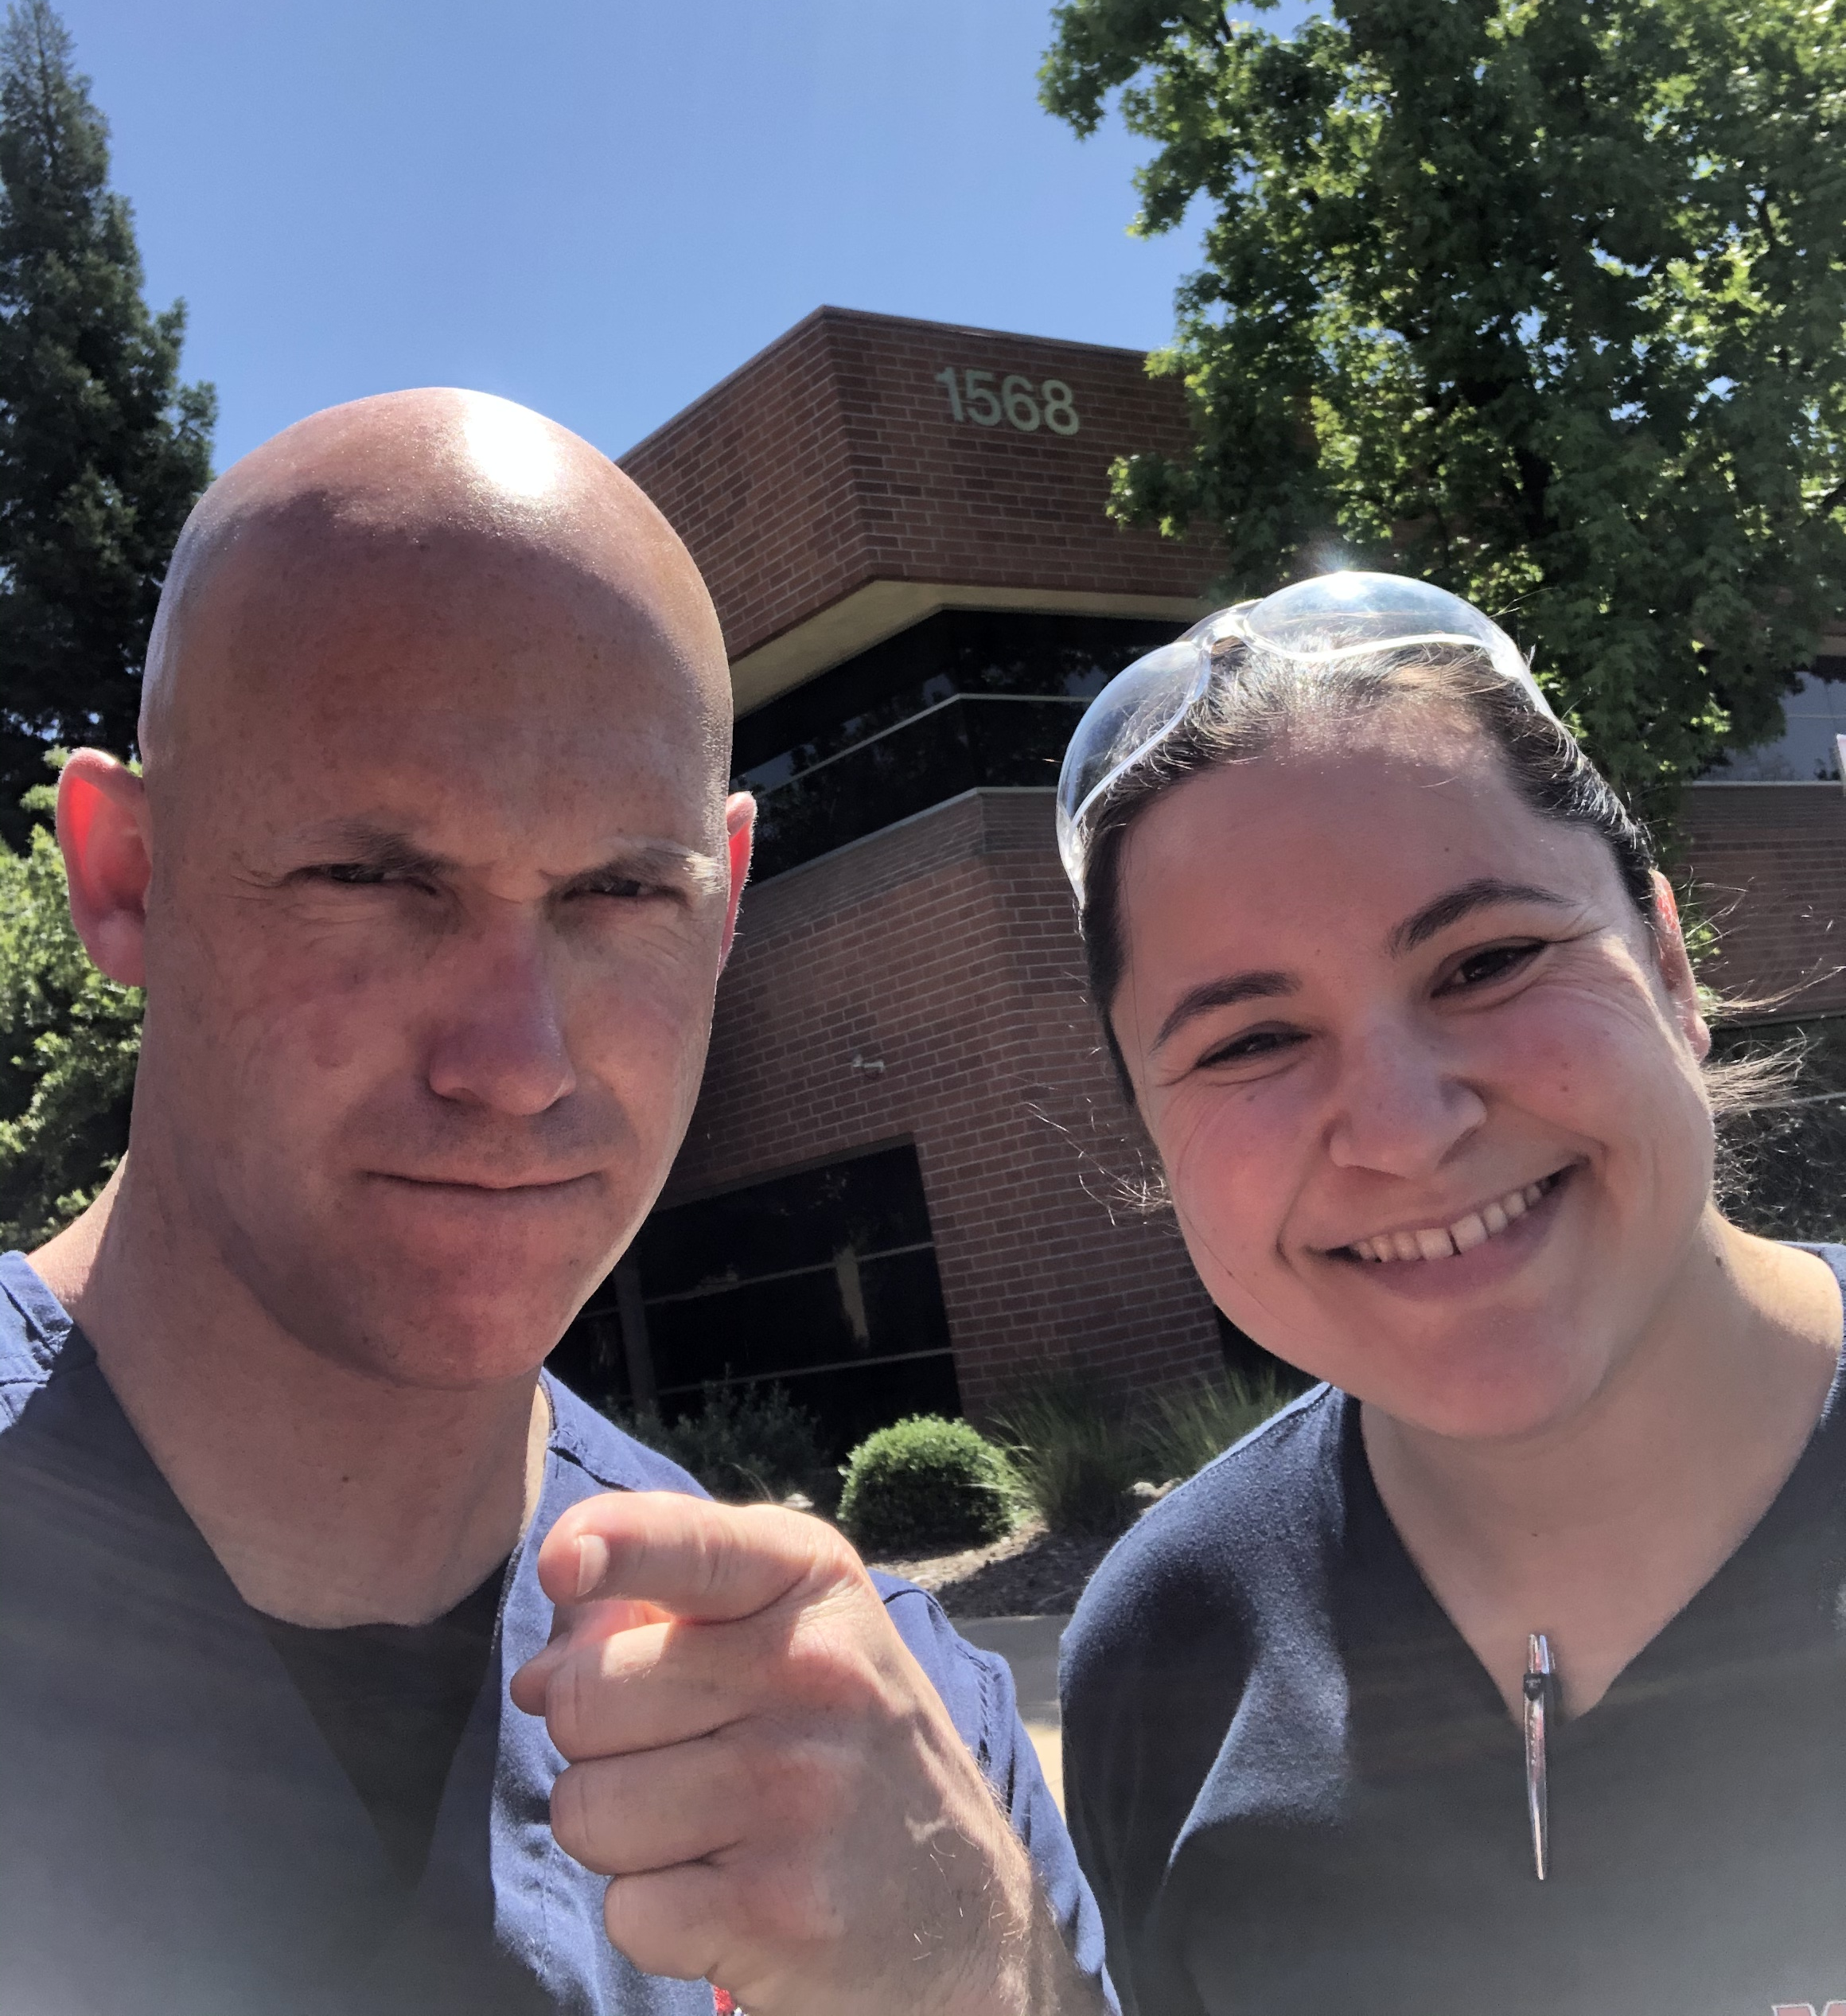
The Start
November 15th 2021

Slide 7

THE NUMBERS
193 - Incidents
407 - Phone calls
152 - Follow up visits
2 – Emails to Dr. Offices
754 – Total MIH interactions
Pre MIH intervention Post MIH intervention Reduction
High Utilizer Total calls 652 368 43.6%
911 System 20 (total calls) 3 (required ED transport) 85% Treat and Release on Scene
Cost Savings of $1,083,290

Slide 8
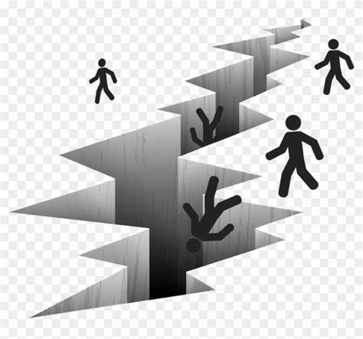
Falling through the cracks

Slide 9
Description | 2020 Proposed Budget ($) | Nov. 2021/2022 Actuals ($)
Program Coordinator | 219,135 | 198,869
Advanced Provider | 225,228 | 83,878
Firefighter /Paramedic | 155,637 | 142,555
OT Cost for Personnel | 30,000 | -
Medical Director | 65,000 | 30,000
Fuel | 10,000 | 2,600
Vehicle Supplies | 60,000 | -
Soft Supplies | 19,000 | 7,997
Unit Maintenance | 5,000 | -
Data Analyst | 25,000 | -
ImageTrend | 20,500 | 27,182
Vehicle Comms/Radios | 60,000 | 30,690
Insurance | 21,500 | 15,632
Training | 5,000 | 139
IT | 3,000 | 6,412
Promotional/Education | 50,000 | -
Response Vehicle | 50,000 | 41,425
Administrative Cost | 80,135 | 24,657
Totals: | 1,104,135 | 612,036
Remaining Budget
$508,896

Slide 10
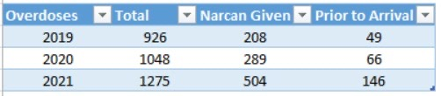
Low Acuity Incidents EMD (Alpha/Omega)
  Emergency Medical Dispatch (EMD Alpha/Omega) Incidents
  2019 – 18,063
  2020 – 18,137
  2021 – 18,263

Slide 11
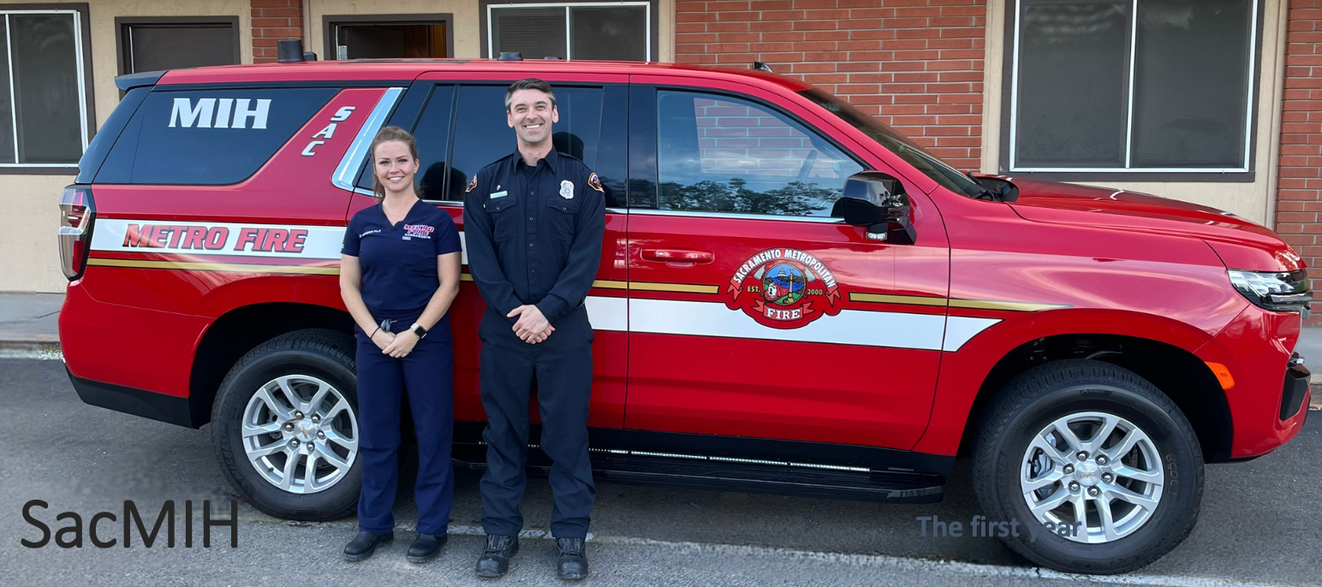
No Door is the Wrong Door: Pathways to Healthcare
Substance use
911 System
Low acuity 911 calls routed to MIH
Referrals from outreach groups
Treat low acuity calls
med refills, lacerations, etc
Ambulance / Medic Referrals
Psychiatric care
Help with outpatient follow up
Very new process
only 20
Future surge / pandemic response
Unhoused population
Buprenorphine
Clinic follow up
SUN
Narcan
Hospital High Utilizer
Red circles are established pathways to the MIH
Blue are pathways we have been working on and are close to utilizing
Green are part of the long term plan or contingency

Slide 12


