Slide 1
SCHC Mobile Integrated Health Unit and Street Medicine Services
Presentation to PHAB by :
Dr. Susmita Mishra , Dr. Mary Kathryn Orsulak
January 4th, 2023

Slide 2
Susmita Mishra M.D. Medical Director Sacramento County Health Center Department of Primary Health Mary Kathryn Orsulak M.D. Assistant Professor at UCD Department of Family Medicine Homeless Program Lead, Sacramento County Health Center Sacramento County Department of Public Health

Slide 3
Objectives
Who are the Sac County Primary Health Mobile and Street Medicine team?
Mission and Goals
Current and Future Services
Who are we collaborating with?
Challenges and Solutions

Slide 4
Sac County Primary Health Mobile & Street Medicine TEAM
Mobile and Street Medicine Team
Dr. Mary K Orsulak - UCD Family Medicine
Dr. John Landefeld -UCD Internal Medicine
Rachel Reed- Medical Assistant, County Public Health
Care Management Nurse (Pending)
Public Health Aide (Pending)
County Public Health Sexual Health Team

Slide 5
Sacramento County Primary Health Loaves and Fishes Team
SCHC Homeless Team at Loaves and Fishes
Dr. Mary K Orsulak- UCD Family Medicine
Dr. John Landefeld- UCD Internal Medicine
Dr. Melody Tran- UCD Internal Medicine
Dr. Kirti Malhotra- UCD Internal Medicine
Dr. Rachel Robitz- UCD Family Medicine / Psychiatry
Dr. Susmita Mishra- Sac County Internal Medicine
Ailing Wei- PHN, County Primary Health
Alexs Podlubny- AMFT, SUPT Counselor- County Behavior Health

Slide 6
Mission & Goal
In partnership with community organizations, SCHC Mobile Integrated Health Unit will bring comprehensive, low-barrier, compassionate healthcare to the people living in encampments in Sacramento County.
Goals :
Define inequities in health outcomes for people experiencing homelessness
Reduce inequities in health services access among people experiencing homeless
Include people with lived experience in program design and development
Partner with community and governmental organizations to increase referrals to housing and other services
Provide evidence-based substance use disorder treatment

Slide 7
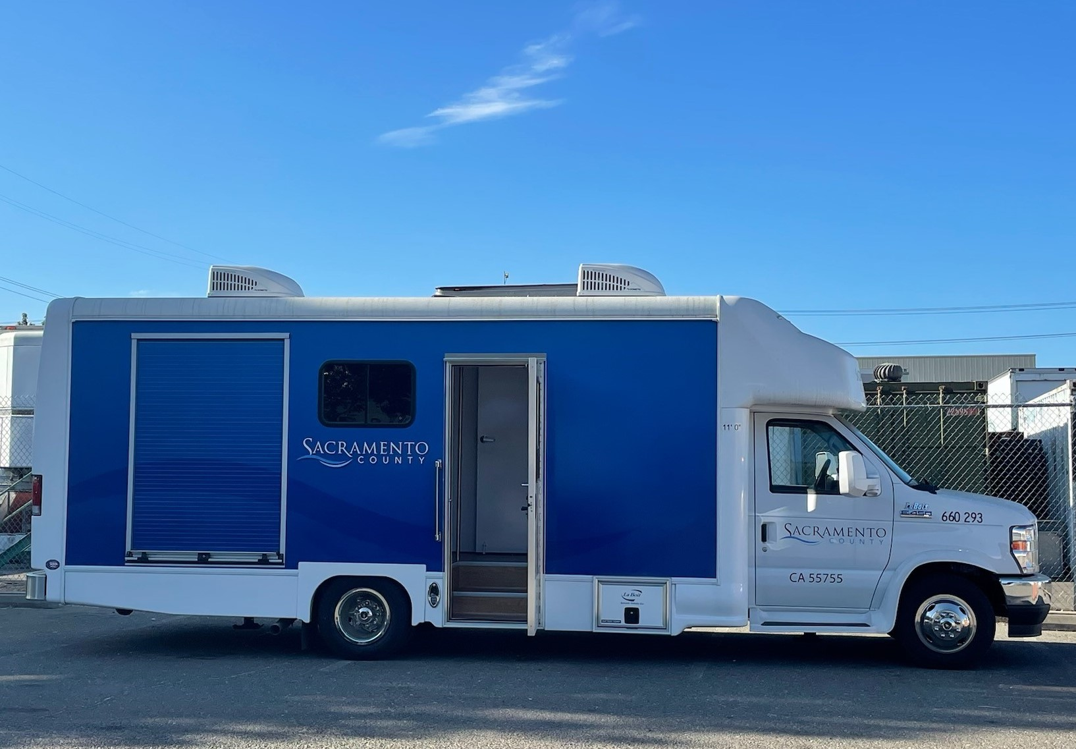

Slide 8
Services
Current Mobile and Street Medicine Services
Acute Care Evaluations
Longitudinal Primary Care Visits
Wound Care
STI testing (in partnership with Sac County Public Health) : Rapid HIV, Hep C, Rapid Syphilis & Multi-site CT/GC
TB testing and provision of TB cards
Immunizations
Medication storage and dispensing

Slide 9
Services
Future Mobile and Street Medicine Services
Provide above services at additional locations
Increase the number of street service medicine service days
Linkage to Enhanced Care Management and Community Support Services
Partner with County, City, Community organizations to coordinate services

Slide 10
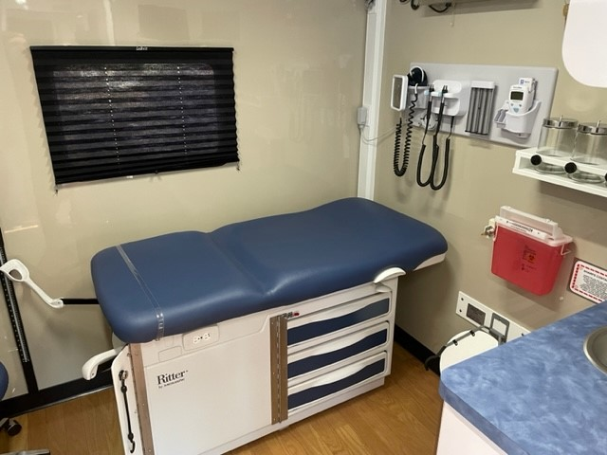
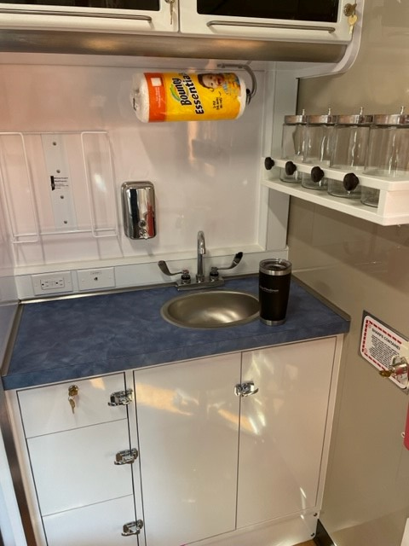

Slide 11
Community Partners
Current:
County Public Health and UC Davis
Potential:
County Behavior Health- HEART Team
Community Based Organizations
Office of Homeless Initiatives
Other Street Medicine Providers

Slide 12
Challenges
Many agencies and programs involved in the street medicine service arena
Good challenge but many of us are working in silos
Billing and funding for services to clients , who are not assigned to the clinic and for non-direct medical services’

Slide 13
Opportunities & Solutions
Enhance current partnerships with Public Health and UC Davis
Continue to meet and talk to other agencies to find out where we can partner, merge or link services

Slide 14
Conclusion
We are entering into a new arena.
It’s exciting and challenging!

Slide 15
Contacts
Dr. Andrew Mendonsa , SCHC Clinic Services Division Manager Mendonsaa@saccounty.net
Dr. Susmita Mishra, SCHC Medical Director MishraS@saccounty.gov
Dr. Mary K Orsulak- UCD Family Medicine OrsulakMa@saccounty.gov
Dr. John Landefeld- UCD Internal Medicine Landefeldj@saccounty.gov

Slide 16
Q & A

