Slide 1
Wellness Outside Walls
PRESENTATION TO PHAB BY:
MICHAELA GIST MSN, APRN, FNP-C
FEBRUARY 1ST, 2023

Slide 2
Objectives
Who is the Elica Health Centers Wellness Outside Walls team?
Mission and Goals
Current and Future Services
Who are we collaborating with?
Challenges and Solutions

Slide 3
Mobile and Street Med Team

Slide 4
Mission and Goals
Healing with Heart
To provide services to two primary groups:
hard to reach populations with barriers to accessing care
underserved students at select schools
Increase access to care to hard-to-reach populations
Reduce use of local ETC departments and tax-funded services, such as fire and police.

Slide 5
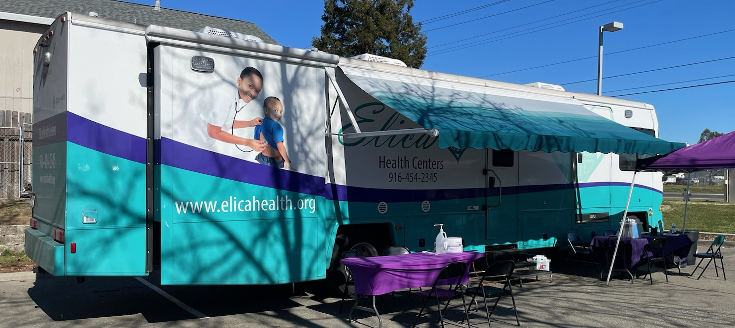
Heath on Wheels (HOW) 1
Ages 4+ with peds focus
Current Services
Well Child Checks
VFC Immunizations
Sports physicals
Primary care
Urgent care
School-based clinics
Twin rivers
San Juan
Notes:
HOW mobile clinics visit area schools to provide primary care and related services, including vaccinations, sports physicals, and more. We do this by invitation from the schools or through formal agreement
POCT: Hb, Lead, UA, A1C, Flu, Strep, HCG, COVID, Glucose
Procedures: cryotherapy, EKG, Nebulizer, Ear Lavage, Pap/Pelvic Exam, I&D, Staple removal, DM foot filament exams
VFC Immunizations: Pediarix, DTaP, Hib, IPV, MMR, Varicella, ProQuad, Kinrix, Hep A, Hep B, , Prevnar, Pneumovax

Slide 6
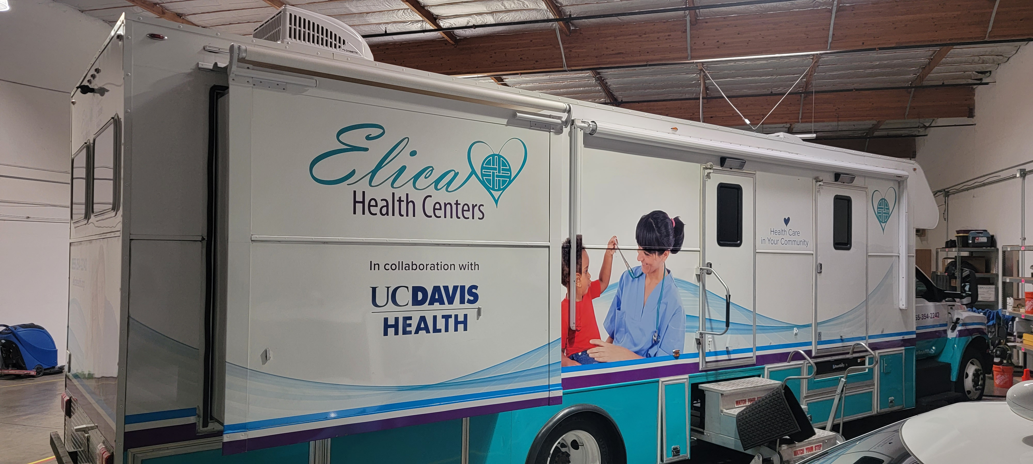
HOW 2
Not currently running
Pending contact signing with Elk Grove School district
Similar focus as HOW 1
Ages 4+ with peds focus
Notes:
Future: VFC Vaccination

Slide 7
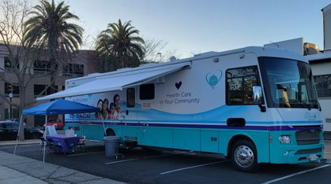
HOW 3
Current Services
Primary Care
Urgent Care
Women's Health
Immunizations
Future Services
Long-acting reproductive contraception
MAT
PrEP
VFC Immunizations
HRS
Ages 4+ with adult focus
Notes:
POCT: Hb, UA, A1C, Flu, Strep, HCG, COVID, Glucose
Future CBC, CMP, BMP, Lipids with clinical chemistry system Piccolo
Procedures: cryotherapy, EKG, Nebulizer, Ear Lavage, Pap/Pelvic Exam, I&D, Staple/suture removal, DM foot filament exams
Immunizations: influenza with availability to carry
Future LARC Services
IUD- Mirena and Kyleena
Nexplanon

Slide 8
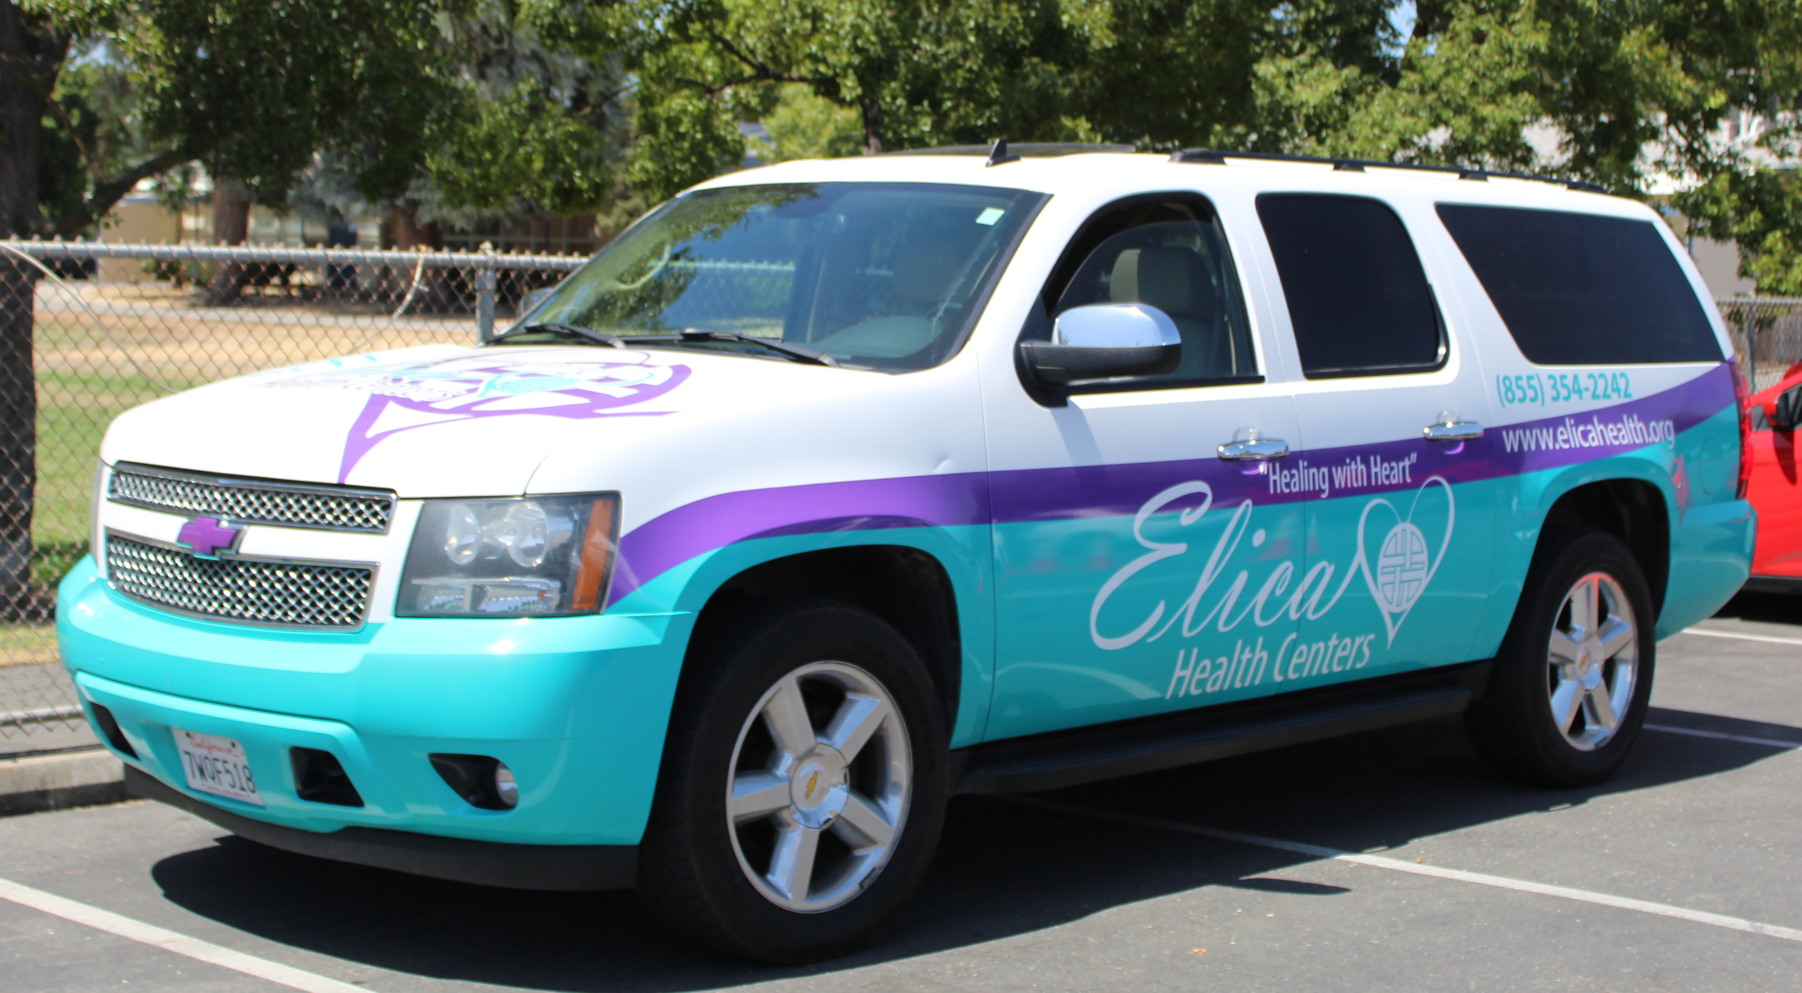
Street Med
Current Services
Urgent care
Vaccinations
Influenza
COVID
Future Services
Mental health
Coordinate with
CAN team
Notes:
POCT: Hb, HCG, UA

Slide 9
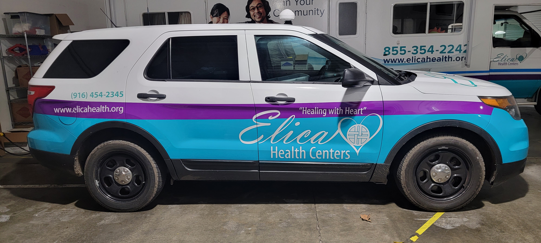
Street Vet
Basic acute care
Cats and dogs only
Vaccines
Dog-
Rabies
Distemper
Hepatitis
Parvo
Parainfluenza
Cat-
Rabies
Feline viral rhinotracheitis
Calicivirus
Panleukopenia
Notes:
Core vaccines are recommended regardless of living conditions. For outreach purposes even though there are considerations for Canine Leptospirosis and Feline Leukemia vaccines as "core" we are providing basic services only as opposed to comprehensive. All vaccines need boosters periodically to ensure optimal immunization.
Rabies: Legally required for both cats and dogs. Pets can receive vaccine as early as 3 months old.
Canine - DHPP (usually all antigens are included in a single vaccine). Initial series started at 6 weeks and every 2-4 weeks until 16 weeks of age.
Feline - FVRCP (usually all antigens are included in a single vaccine). Initial series started at 6 weeks and every 2-4 weeks until 16 weeks of age.

Slide 10
Who are we collaborating with...
First Steps
BAART
VOA shelters
UC Davis
Sacramento Steps Forward
MEDMARK
StepUp
Quest
Twin Rivers School District
San Juan School Disctrict
Various churches
Saint John's Program
Notes:
Churches: Capitol City 7th Day Adventist, First church of Nazarene, South Sac Christian Center, St. John's Lutheran Church, St. Paul's Church, Westminster Presbyterian

Slide 11
Challenges and Solutions
Billing for sustainability
Working to bring in more services
This is a topic at the upcoming NorCal Mobile Health Care Alliance Coalition meeting on March 9th
Patients assigned to other organizations limits our services
We have ability to assist patients in switching should access to care with the other organization be an issue
Staffing
We have the jobs posted
Many mobile providers in the county working in silos
Mobile Medicine Coordination Meetings

Slide 12
Phone Numbers for Services
Elica Main Line: (916) 454-2345
HOW I: (916) 955-2030
HOW III: (916) 200-8385
Street Medicine: (916) 995-1328
Animal Services: (916) 205-3858 - Thursdays and Fridays Only

Slide 13
Key Leadership Contacts
Associate Medical Director for Mobile and Outreach Services
Michaela Gist
Mgist@elicahealth.org
(812)686-6869
Mobile Manager
Anna Dombrovskaya
Adombrovskaya@elicahealth.org
(916)454-2345 ext. 857

Slide 14
Mobile Calendar
https://www.elicahealth.org/health-on-wheels-and-street-medicine-calendar/

Slide 15
THANK YOU FOR ATTENDING
http://www.elicahealth.org

